Slide 1
DATA ANALYTICS WITH R
AN INTRODUCTION

Slide 2
What is Data Analytics
Data analytics is the process of extracting, examining, cleaning, transforming, and interpreting raw data to extract meaningful insights, patterns, and trends. By using various tools, techniques, and statistical methods, data analytics empowers businesses and individuals to extract valuable information from many datasets, which can be used for a wide range of purposes.
What is R
R is a powerful programming language and open-source software environment and a tool for data analysis, statistical computing, and graphical representation.

Slide 3
Download & Install R
To download R, go to the official R website: Visit the Comprehensive R Archive Network (CRAN) website at https://cran.r-project.org/.
Download & Install RStudio
To Efficiently use R, You are going to need an integrated development environment (IDE).
To download RStudio, go to the RStudio website: Visit the RStudio website at https://posit.co /download/rstudio-desktop/.

Slide 4
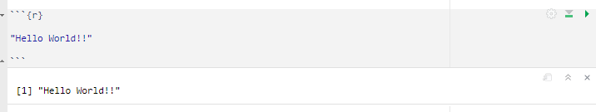
Hello World!!
In R, when you type an expression or a value directly into the console, it will automatically be printed.

Slide 5
Arithmetic Operation in R
R offers various arithmetic capabilities, including basic arithmetic operations
Addition
Subtraction
Multiplication
Division

Slide 6
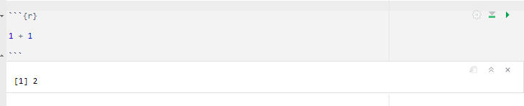
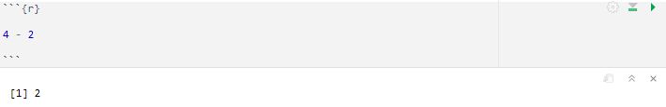
Addition: Addition is the arithmetic operation used to combine two or more numbers to find their sum. The addition operator in R is denoted by the plus sign ( + ).
Subtraction Subtraction is the arithmetic operation used to find the difference between two numbers. It represents the process of taking away one quantity from another. The subtraction operator in R is denoted by the minus sign ( - ).

Slide 7

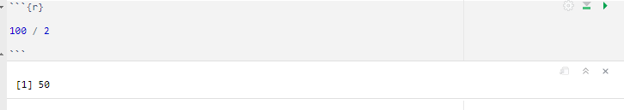
Multiplication: Multiplication is the arithmetic operation used to find the product of two or more numbers. It represents the process of repeated addition. The multiplication operator in R is denoted by the asterisk ( * )
Division: Division is the arithmetic operation used to distribute a quantity into equal parts or to find the quotient when one number is divided by another. The division operator in R is denoted by the forward slash ( / ).

Slide 8
DATA TYPES
In R, there are several data types that are used to represent different kinds of data. Understanding these data types is crucial for data analysis, as they determine how the data is stored, processed, and manipulated. Here are the main data types in R
Numeric
Character
Logical
Date
Factor
Complex

Slide 9
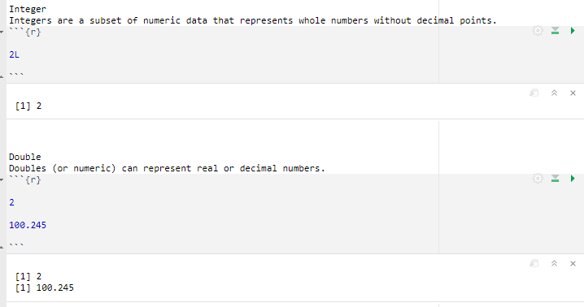
Numeric Data Type
This data type is used to represent real or decimal numbers

Slide 10
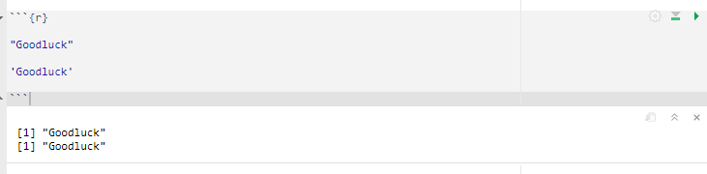
Character Data Type
The character data type is used to represent text or strings. Text in R should be enclosed in single ( ' ' ) or double quotes ( " " ).

Slide 11
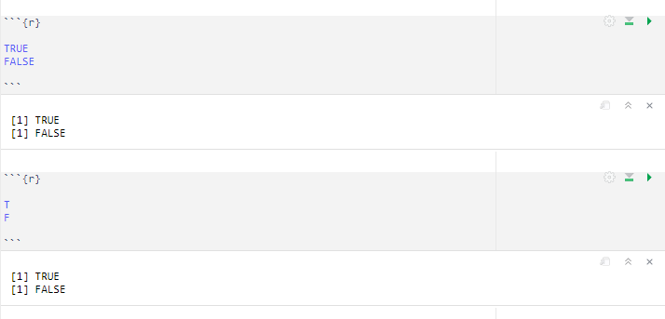
Logical Data Type
The logical data type represents Boolean values, which can be either TRUE or FALSE. Logical values are often used for conditional expressions and comparisons.

Slide 12
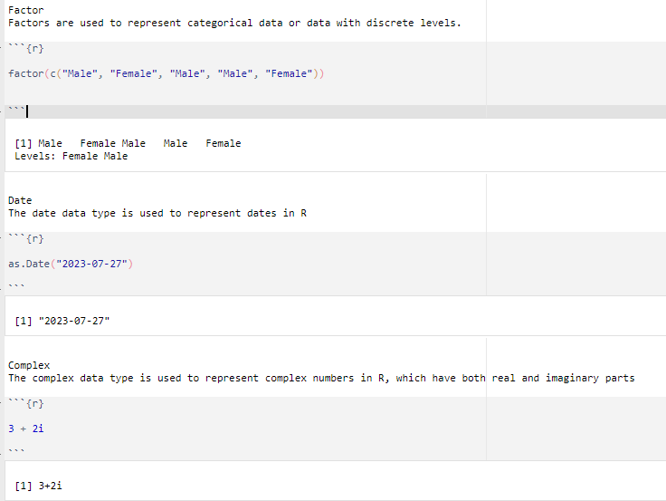
Other Data Types

Slide 13
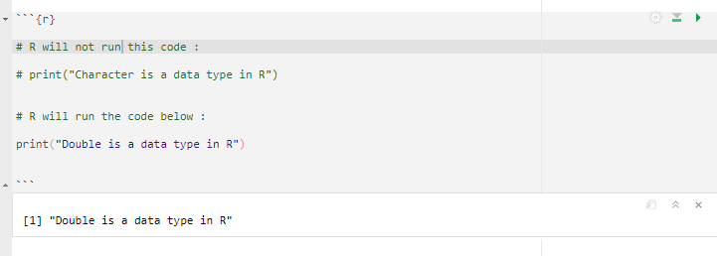
Comment in R
In R, you can add comments to your code to provide explanations, document the code, or temporarily disable certain lines without affecting the program's execution. Comments are not executed as part of the code; they serve as notes for the developers or readers.
To add comments in R, you can use the `#` symbol. Anything after the `#` symbol on the same line is considered a comment and will not be executed

